Slide 1
FIT History Tours
Tyler Zars, Grant Butler, Matt Tokarski, Cameron Miskell

Slide 2
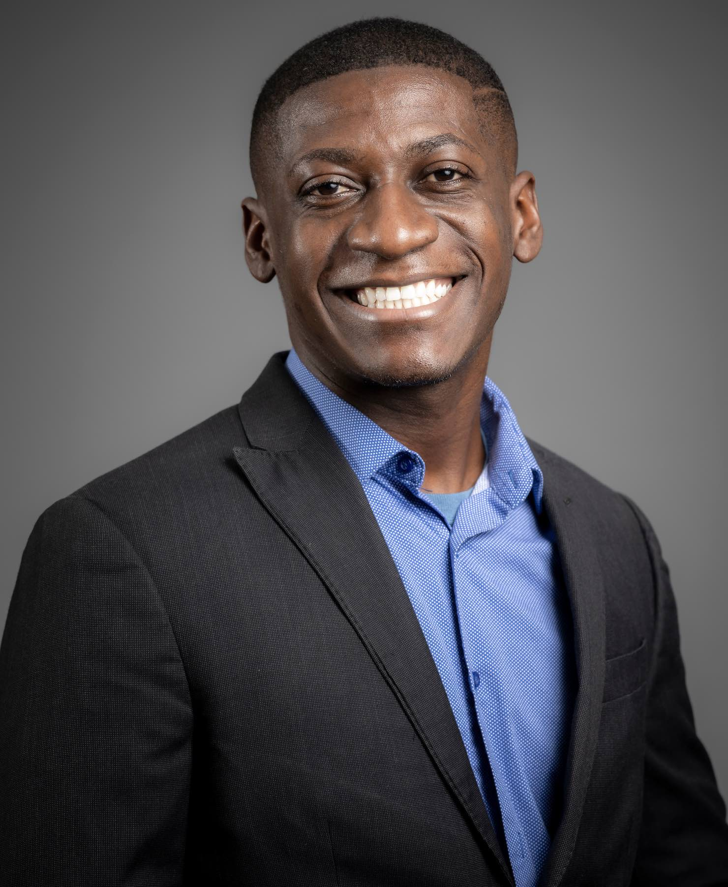
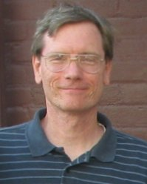
Faculty Advisor and Client
Faculty Advisor: Dr. Fitzroy Nembhard (fnembhard@fit.edu)
Client: Ryan Stansifer (ryan@fit.edu)

Slide 3
Our Goal
Goal: To provide users with a mobile suite for navigating the Florida Tech campus while engaging them with historical content:
Photos
Videos
Trivia
such that the campus experience is memorable and educational.

Slide 4
Motivation
Campus Tours today are:
Pros | Cons
Led by students Visit popular landmarks Explain area purposes Can ask questions | Have a set pace Limit exploration Are detached from campus life Lack impact Formulaic, follow one path Information is not always accurate
Notes:
Currently, campus tours provide information about the purpose of each area/building but do not establish connections with the visitors and prospective students, leaving participants detached and easily forgetting the layout of the university. By providing historical information, this project seeks to establish at least a single point of connection with each point of interest, both entertaining and solidifying the memory of where to find a given resource at Florida Tech.

Slide 5
Primary Features
Feature #1: Explore the beautiful campus of Florida Tech at your own pace with our guided walking tours, housed completely within the app! Navigate to your desired point of interest with ease as the GPS shows which paths to take in real-time! Take the scenic route with the “Sightseeing” option, or arrive in no time with the “Fast Travel” option.
Feature #2: Virtual Tours: Discover the landmarks and history of Florida Tech without setting foot on campus! Select locations on the map to see an image/video with narration about each place!
Feature #3: Compete in trivia games as you walk around campus to win prizes. Bridge the gap between education and fun with our Jeopardy style trivia during your tour and rack up points while you learn about each landmark! Make your own path as you search for points of interest in a scavenger hunt! Deepen your connection with campus as you play games on the tour.

Slide 6
Technical Challenges
Challenge #1: Mobile App development/deployment
Challenge #2: Learn JavaScript/Choose Framework
Challenge #3: Applying the Software Development paradigms taught in previous semesters to one large project.
Challenge #4: Dynamic UI/UX Development (ReactJS)
Challenge #5: Content Management Systems Implementation

Slide 7
Novel Ideas
An active timeline that appears during a tour when a history “event” is triggered, visually scrolling backward from the current year to the date of the past event. Used as an indication that a mini-game or trivia section is about to begin. This is novel because we have never seen a dynamic timeline implemented in any app graphically to express to the user when an event happened, only static dates in the header/footer.
(Tentative) Augmented reality tags located throughout the campus and generate a visual model in 3D space when scanned during a guided tour within the app. This feature may occasionally be present in museum tours but has not been encountered during a college campus tour before.

Slide 8
Milestone 1
Select and Learn a JS Framework for Development
Select and Learn a Mobile Development Toolkit for iOS/Android
Begin to Collect Historical Research and Images for the Application
Create UI Mock-Ups and Get Client Feedback
Create Requirement Document
Verify and Validate Requirements
Create Design Document
Create Test Plan

Slide 9
Milestone 2
Milestone 3
Implement and Deploy Basic Web App/Mobile App
Choose GPS/Location Framework/API
Build Out Historical Database
Develop UI Further
Implement Timeline
Test GPS Popup On Arrival at a Location
Validate Historical Database into Application Timeline

Slide 10
Task Matrix: Milestone 1
Task | Grant | Tyler | Matthew | Cameron
Select and Learn a JS Framework | 25% | 25% | 25% | 25%
Select and Learn Mobile Development Toolkit | 55% | 15% | 15% | 15%
Investigate Hosting Options and Needs | 15% | 55% | 15% | 15%
Compare and Select Collaboration Tools | Calendar Software for Team/Client Meetings | Documentation Software and UI/UX Preview Software | Presentation and Communication Tools | Version Control and Code Reviews
Begin to Collect Historical Research | 15% | 15% | 55% | 15%
Requirement Document | Write 15% | Write 15% | Write 15% | Write 55%
Design Document | Write 35% | Write 15% | Write 35% | Write 15%
Test Plan | Write 15% | Write 25% | Write 15% | Write 45%

Slide 11
Questions?

